Slide 1
WHO IS THE MOST DIFFICULT PERSON TO FORGIVE?
SELF-FORGIVENESS

Slide 2
THE PROBLEM?
Self-condemnation
Negative ruminations
Self-contempt/Self-hate

Slide 3
Cost of not forgiving myself
Live in condemnation
Unable to be in community
Unable to engage in the joy of life
Impaired in giving and receiving love

Slide 4
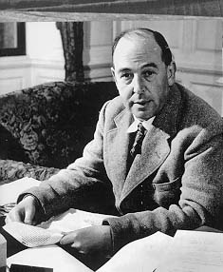
I think that if God forgives us we must forgive ourselves. Otherwise it is almost like setting up ourselves as a higher tribunal than Him.
Letters of C. S. Lewis (19 April 1951), p. 230

Slide 5
Matthew 22:37-40 – 3 TYPES OF RELATIONSHIPS
Jesus replied: “‘Love the Lord your God with all your heart and with all your soul and with all your mind.’ This is the first and greatest commandment. And the second is like it: ‘Love your neighbor as yourself.’ All the Law and the Prophets hang on these two commandments.”
OBEJECT OF RELATIONSHIP
Your God
Neighbor (Other)
Self

Slide 6
An Operational Definition of Love
Seeking and Doing Good for the Loved One
D. R. Green

Slide 7
Parameters of Love (D. R. Green)
Love ≠ Pleasing
Love ≠ Feeling Loved
Love comes from the one who love
Love is not earned, can not be earned, but given as a gift

Slide 8
FORGIVENESS is LOVE APPLIED
Choice to release resentment
Choice to release desire for revenge
Wish, seek good for the one who wronged me

Slide 9
WHEN TO FORGIVE? 2 QUESTIONS
1. What Has Occurred?
Wrongdoing? Transgression? Sin?
Preference?
2. Who is Responsible?
Me?
Other?

Slide 10
WHAT HAS OCCURRED?
Preference
What I want – What I do not want
If Preference – change expectations - accept
Moral Transgression
Sinful
Violates love
Not acceptable
Forgive

Slide 11
WHO IS RESPONSIBLE?
Am I?
Is someone else?
How can I know who is responsible?

Slide 12
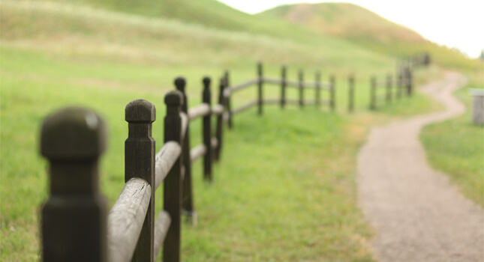
BOUNDARIES
INTERNAL BOUNDAIRES
What is me, my experience
What is not me
EXTERNAL BOUNDARIES
What I will do
What I will not do

Slide 13
DISCERN RESPONSIBILITY
I am responsible for
How I treat myself
How I treat others
My dignity
My Personal Power
My Significance
I am NOT responsible for
How others treat me
Others treat others
Others treat themselves
Recognition of others’ dignity, power, significance
My Freedom
© 1990, 2014, D. R. Green

Slide 14
Forgiving Ourselves
We don’t have to forgive ourselves before we can forgive a transgressor. Yet we must forgive ourselves as well as forgiving the transgressor if it’s going to make much difference in our lives.
Everett L. Worthington
Notes:
Without self-forgiveness, we do not experience the change

Slide 15
10 STEPS TO SELF-FORGIVENESS
Recognize and own the wrong – thoughts and feelings
Discern Responsibility
Own my Responsibility
Receive God’s Forgiveness
Repair Relationships
Challenge Ruminations
Empathy for self
Commitment to Apply God’s Forgiveness of me to me
Rebuild Self-Acceptance
Live in Truth and Love

Slide 16
Benefits of Self-Forgiveness
Able to give and receive love
Inner peace and contentment
See self as our Loving God sees us

Slide 17
Put on then, as God's chosen ones, holy and beloved, compassionate hearts, kindness, humility, meekness, and patience, bearing with one another and, if one has a complaint against another, forgiving each other; as the Lord has forgiven you, so you also must forgive. And above all these put on love, which binds everything together in perfect harmony. And let the peace of Christ rule in your hearts, to which indeed you were called in one body. And be thankful.
Colossians‬ ‭3:12-15

